Slide 1

ARYAN LALKA
DARREN CARVALHO
Research Project
UPTREND PREDICTION
USING DEEP LEARNING TECHNIQUES

Slide 2
TABLE OF CONTENTS
01
OVERVIEW
02
EXPLORATORY DATA ANALYSIS
03
MODELS USED
04
FUTURE ENHANCEMENTS

Slide 3
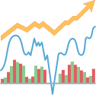
OVERVIEW
Aim : Develop a predictive model to forecast daily uptrend prediction in stock data
Compare the efficacy of the advanced model architectures used to predict uptrend in stock data

Slide 4
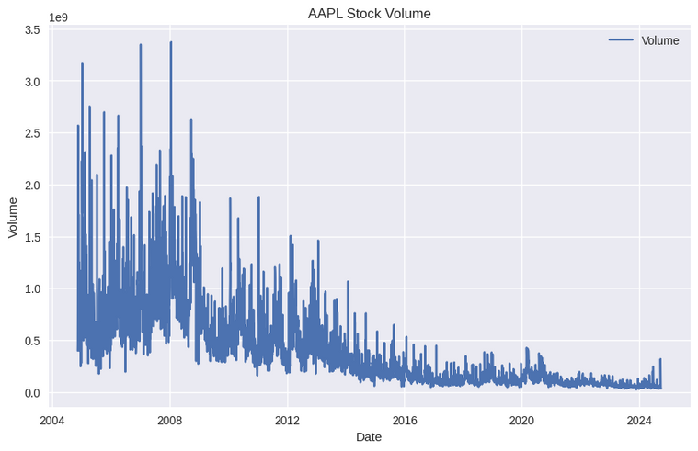
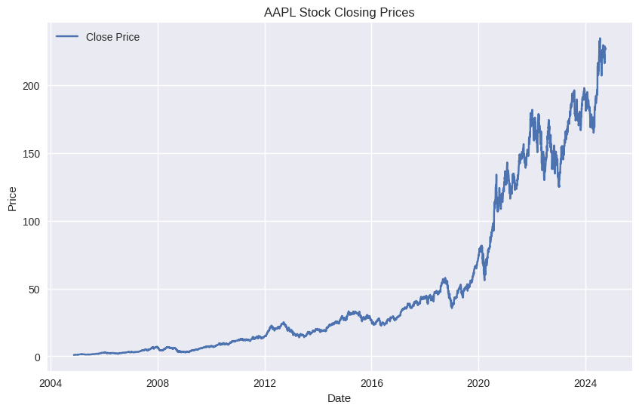
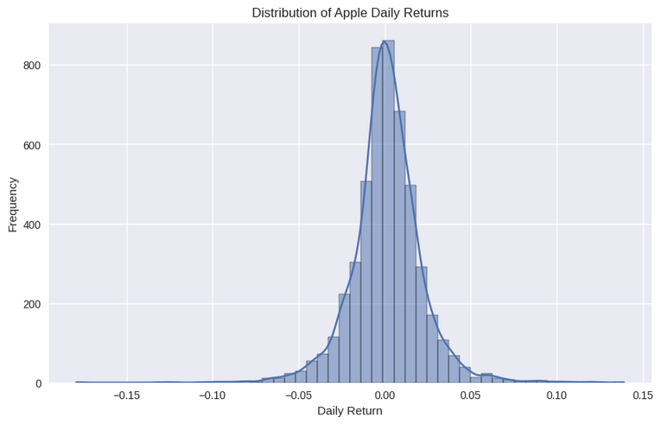
EXPLORATORY DATA ANALYSIS

Slide 5
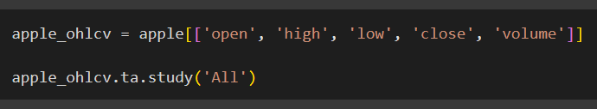
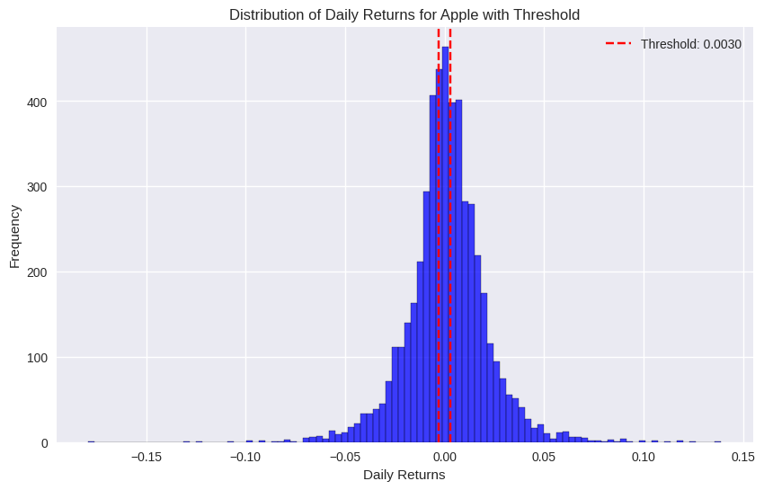
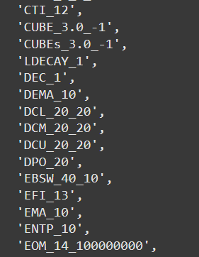
Feature Extraction
Choosing a Threshold
Using TA-Lib Library, we extract features from Open, High, Low, Close and Volume.
Plotting a threshold to signify uptrend with the help of percentiles and standard deviation of stock returns data.
Our chosen threshold is 0.003 or 0.3%
Total number of features now is 346

Slide 6
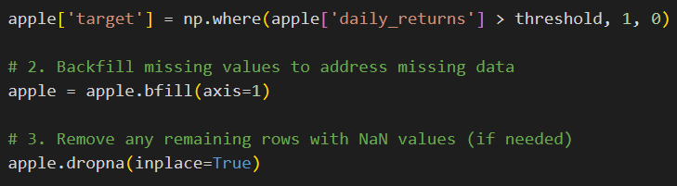
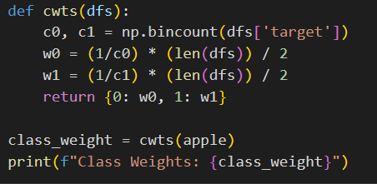
Defining Target Variable
Class Imbalance
The target variable is either an uptrend or no trend. We get an output of 1 if daily returns is greater than 1 which signifies an uptrend, or 0.
The ratio of 1s and 0s in the target variable need to be balanced to that there is no bias while training the model and during prediction.
Furthermore, backfill any missing values and drop NaN values.
Once the imbalance is taken care of, we can move to the next step.

Slide 7
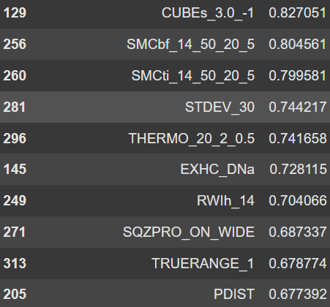
Dealing with Multicollinearity
When dealing with stock data, we need to make sure that all features are independent and there exists no multicollinearity.
To scale the dataset and remove collinear features, we use Variance Inflation Factor (VIF).
We calculate the VIF values for each feature and only select those features with the least VIF. (<1.5)
The features with higher VIF are dropped, and we proceed with the new dataset.

Slide 8
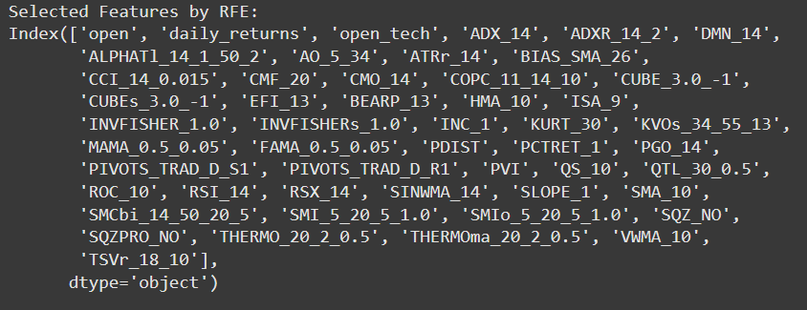
Feature Selection
1. Recursive Feature Elimination
Ranking features on the basis of importance and eliminating those that are not important.
Features with Rank 1 are selected and the rest i.e. ranks higher than 1 are eliminated.
Support Vector Classifier and Random Forest Classifier are used for this.

Slide 9
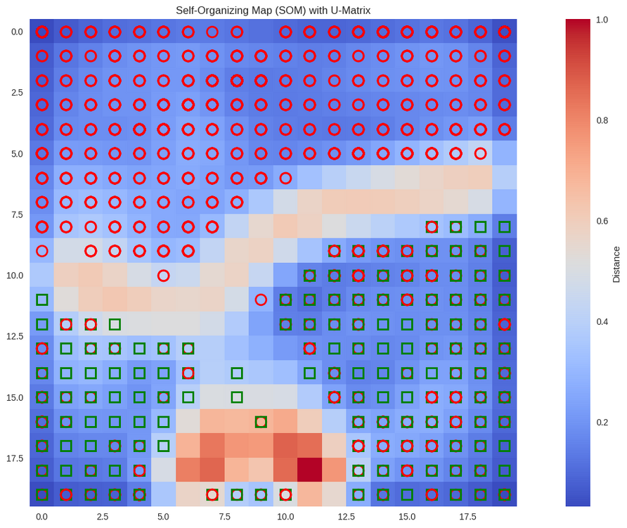
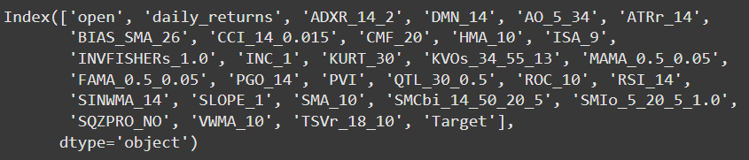
2. Self Organizing Maps
SOM uses the Unified Distance Matrix (U-Matrix) to visualize all the features.
Any overlapping features are said to be highly correlated and so scaling of these features is necessary.
The features are manually dropped and the final dataset of features is used to train and test the models.

Slide 10
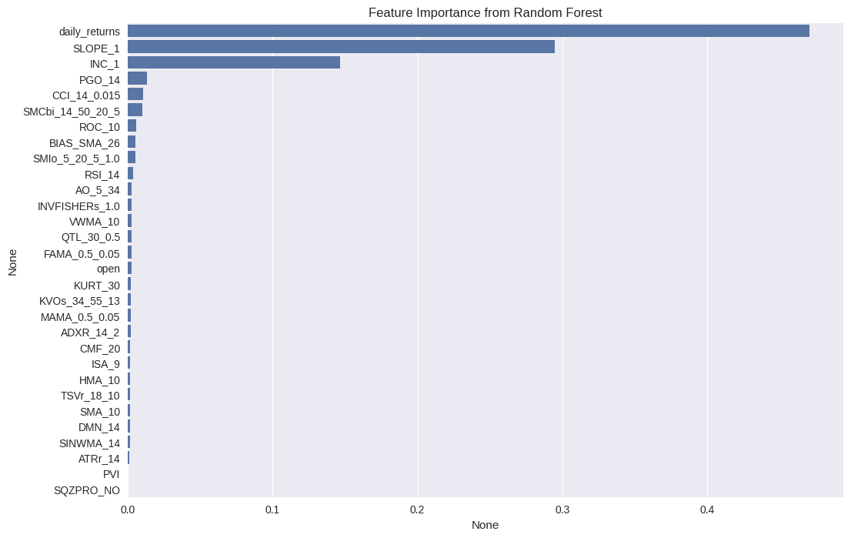
Feature Importance Graph

Slide 11

Machine Learning Algorithms used:
SUPPORT VECTOR MACHINES (SVM)
RANDOM FOREST
Deep Learning models used :
LSTM
GATED RECURRENT UNIT (GRU)
CNN (IMPLEMENTED THROUGH THE USE OF A HYBRID NEURAL NETWORK)

Slide 12
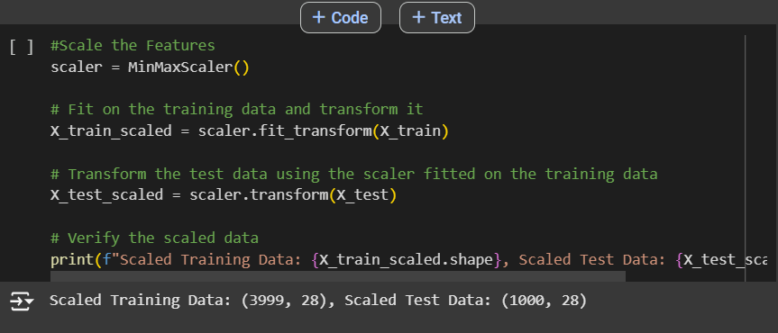

TRAIN-TEST-SPLIT
FEATURE SCALING
Dataset is further divided into training & test datasets.(80/20 split).
Data was not shuffled, in order to preserve chronological order of observations.
Make use of Min-Max Scaler in order to scale data to a range between 0-1
Done in order to ensure that all values are on the same scale

Slide 13
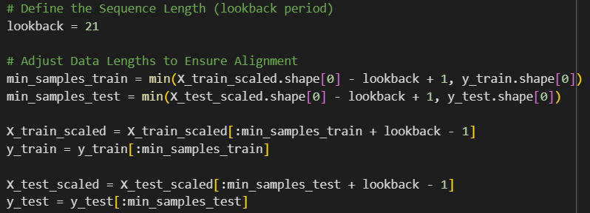
ALIGNING DATA LENGTH
Done to ensure accurate predictions over a set amount of data
Done by defining a lookback period i.e. no of time steps the model back references in order to make its predictions

Slide 14
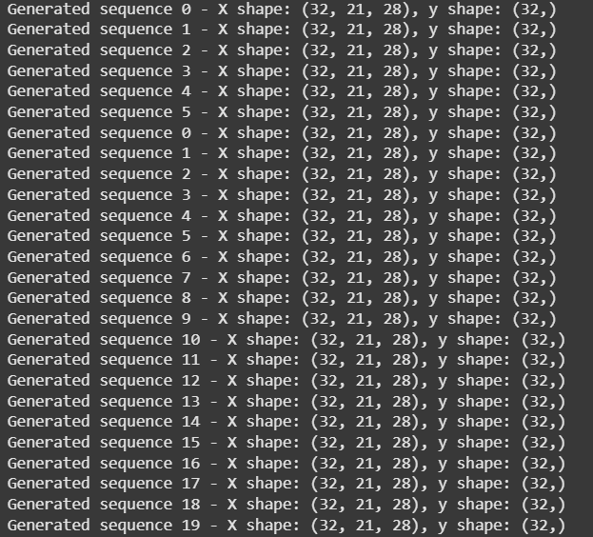
GENERATE INPUT SEQUENCES FOR MODEL INPUT
Input Sequences are generated in order to prepare our data for model input, specifically LSTM models.
We make use of TimeseriesGenerator from Keras to generate these seqs from training and test data
Important Parameters that we keep in mind:
Lookback Period of 21 days (Length).
Batch Size - Data is processed in batches of 32 sequences at a time
Features - 24 features in each sequence

Slide 15
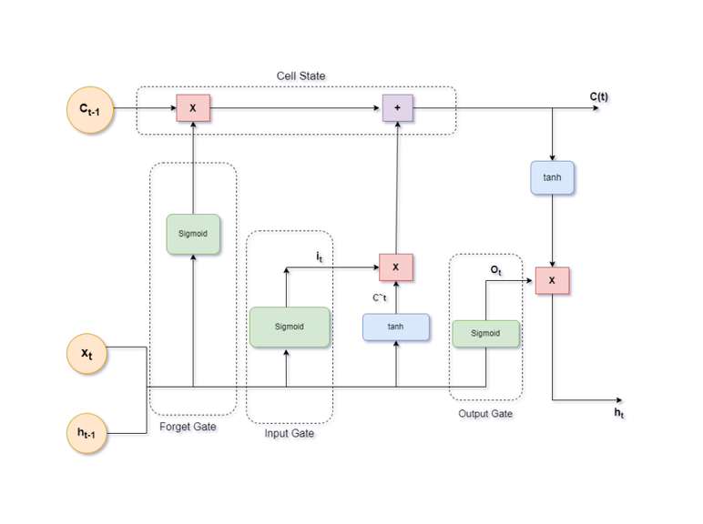

5-LAYER LSTM
Makes use of 5 LSTM Layers, with each layer capturing more intricate patterns that exist in the data.
Used to evaluate if a higher model depth potentially leads to better predictive performance.
Here, we make use of input sequences to feed into this model as LSTMs are known to work well with sequential data

Slide 16
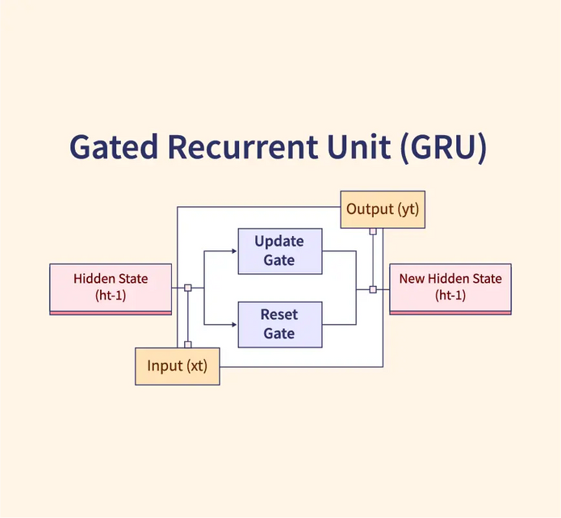

GRU (GATED RECTIFIED UNIT)
replaces the LSTM layers with GRU layers, which are similar to LSTM but with fewer parameters.
Used to explore the efficiency & performance of GRU layers compared to LSTM
Basically, a simplified version of LSTMs.

Slide 17

HYBRID MODEL (CNN+LSTM)
Integrates CNN layers for feature extraction & LSTM layers for sequence modelling
used in order to leverage strengths of both CNN & LSTM to capture spatial & temporal patterns.

Slide 18
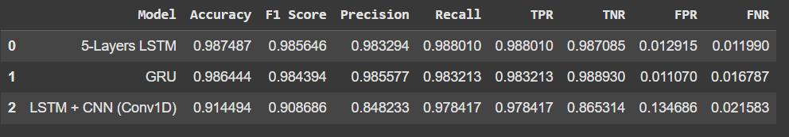
MODEL EVALUATION
BEST MODEL - 5-LAYER LSTM

Slide 19
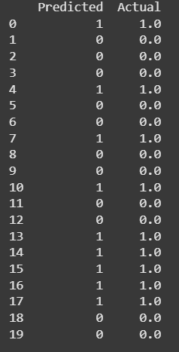
FINDINGS
PREDICTIONS
WE HAVE TAKEN A BINARY MODEL APPROACH WHEN IT COMES TO MAKING OUR PREDICTIONS FOR UPTREND. BASICALLY IT MEANS, 1 = UPTREND AND 0 = DOWNTREND/NO TREND.

Slide 20
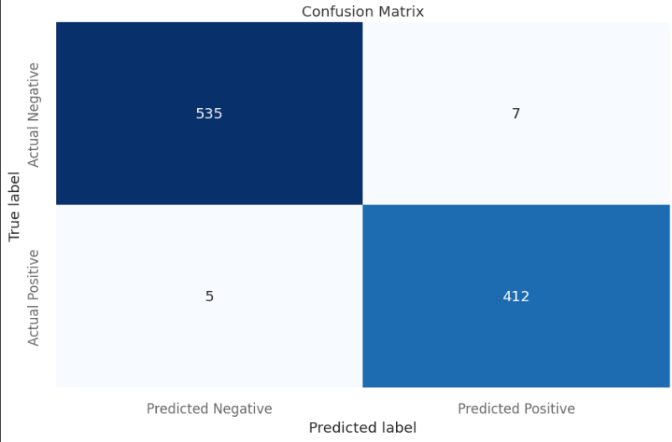
CONFUSION MATRIX
HIGH TP - EFFECTIVE AT IDENTIFYING UPTRENDS
LOW FN - RARELY MISES AN UPTREND WHEN ONE ACTUALLY OCCURS
MODERATE FP - INCORRECTLY PREDICTS UPTREND WHEN THERE ISN’T ONE
HIGH TN - EFFECTIVE AT IDENTIFYING PERIODS WHERE THERE IS NO UPTREND

Slide 21
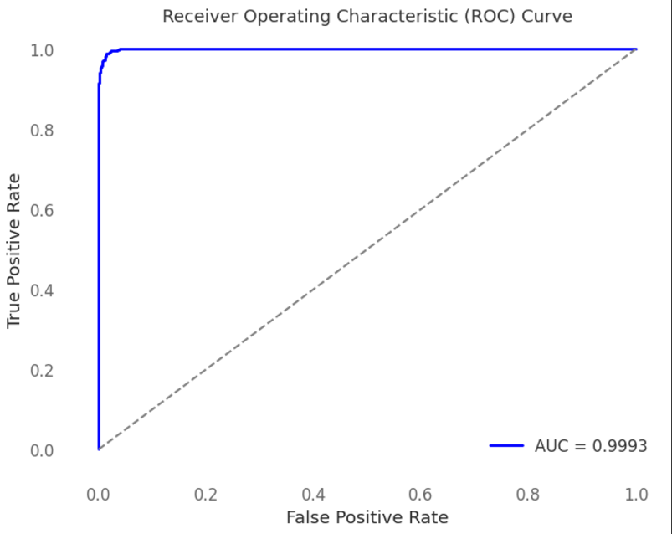
ROC CURVE AND AUC SCORE
graph that shows how well a binary classifier performs by plotting the trade-off between true positive rate (sensitivity) and false positive rate (1-specificity) at different thresholds.

Slide 22

FUTURE ENHANCEMENTS
Additional Data: Gathering more diverse data could improve model generalization.
Portfolio Management: Using the model to manage stocks in a portfolio, generating buy and sell signals.
Model Interpretability: Implementing SHAP (SHapley Additive exPlanations) values or LIME to interpret the model's predictions and feature importance.
Real Time Prediction: Using stock data APIs to be able to get real time data and host a forecasting web app.
Using LLMs: Using LLMs for sentiment analysis to improve prediction with the help of fundamental analysis.

Slide 23
THANK YOU

